Slide 1


PLP PRESENTATION
ON
OPEN CART APPLICATION
BY
GROUP 1 Dated: 09/03/2018

Slide 2

TEAM MEMBERS
Apurv Agrawal (Team Lead)
Abhijit Panda
Lakshmi Bhavani
Bijal Majethia
Anbarasi
Ankur Kumar Gupta
Alauddin Abbas
Dhanalakshmi

Slide 3
OUTLINE
Introduction
Overview of Project
Test Cases
Data Driven Framework
Page Factory
Screenshot for Login
Screenshot for Registration
Test Summary
Q & A

Slide 4
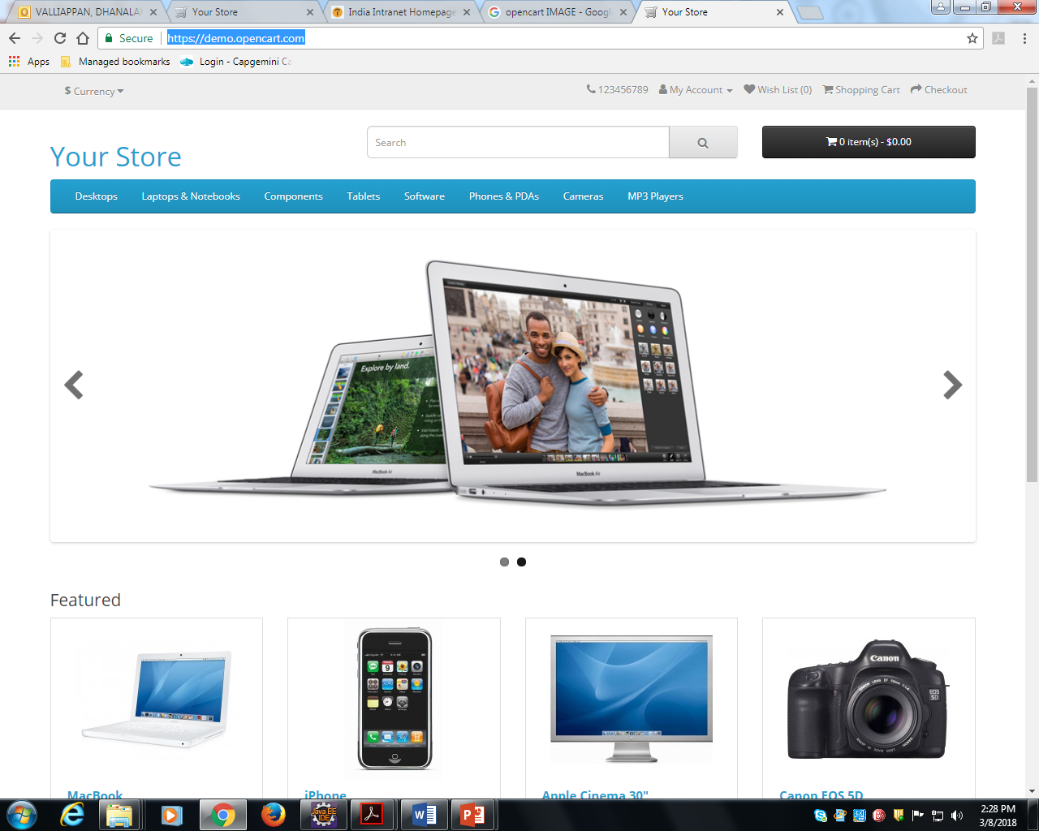
INTRODUCTION
WEBSITE LINK
https://demo.opencart.com/

Slide 5

INTRODUCTION Cont..
The functionalities we tested:-
User Registration
User Login

Slide 6
OVERVIEW OF THE PROJECT
From the Website given:-
Test Cases
Program for Login using Page Factory
Program for Registration using Page Factory

Slide 7
TEST CASES
User Registration
Registration
User Login
Login

Slide 8
DATA DRIVEN FRAMEWORK
A method in which the test data set is created in the excel sheet and fed to the software under test
Tool used to automate web-based applications - Selenium Webdriver
Data not hardcoded with script
Data provided from external source
It is the design of possible inputs provided by the user

Slide 9
PAGE FACTORY
An extension to the Page Object Model(POM).
Used to initialize the elements of the Page Object without using 'FindElement' or 'FindElements'.
Or instantiate the Page Objects itself
Make non-brittle test code and reduce or eliminate duplicate test code
Annotations used to supply descriptive names of target objects to improve code readability.

Slide 10
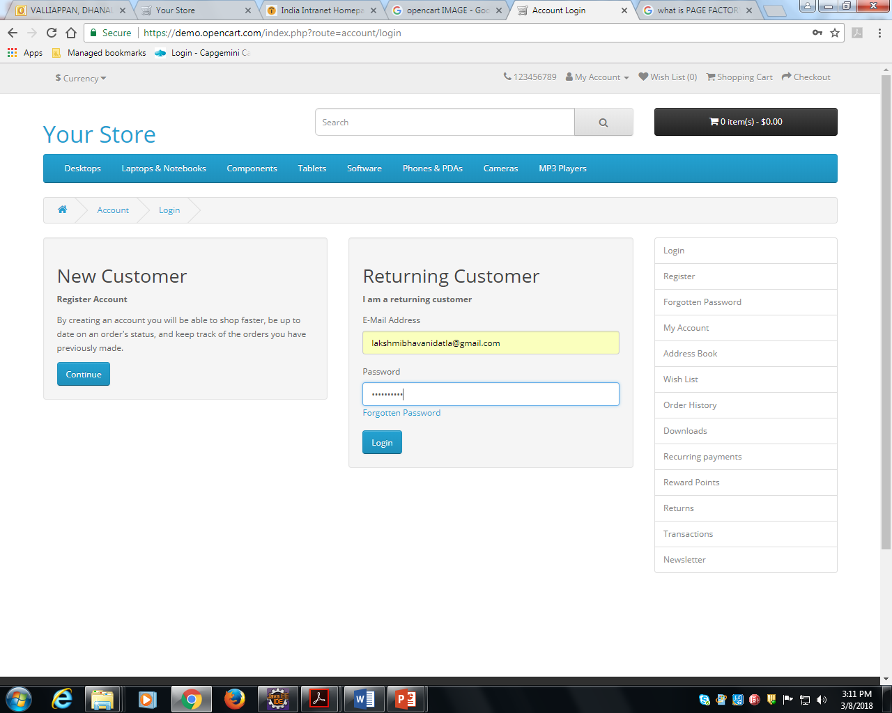
LOGIN PAGE

Slide 11
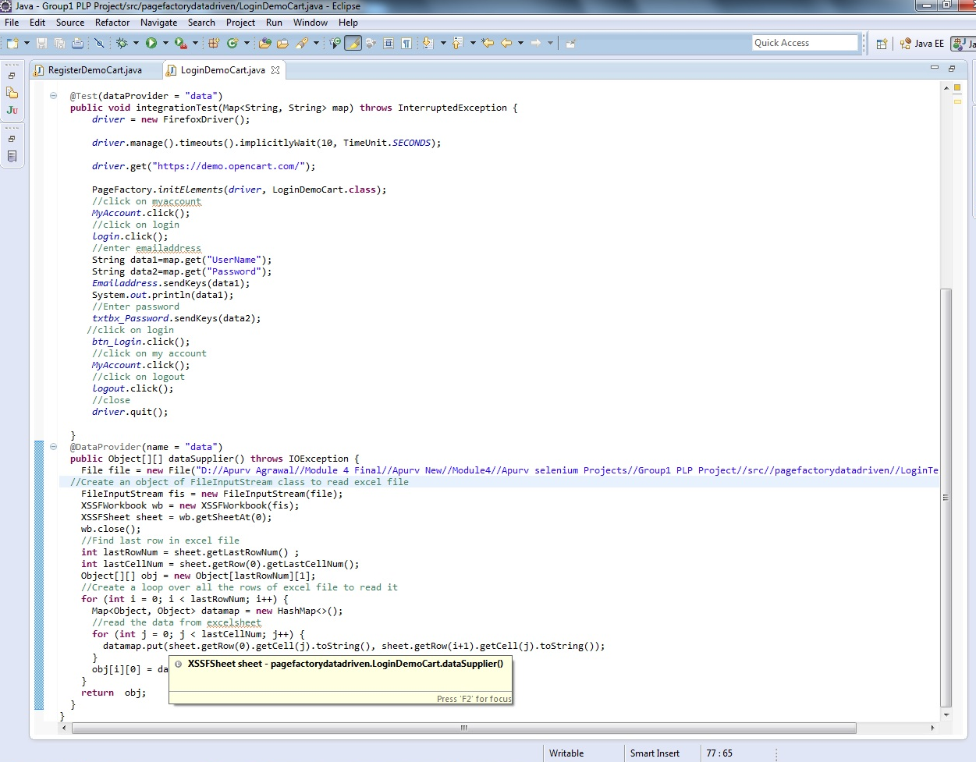
ECLIPSE CODE FOR LOGIN

Slide 12
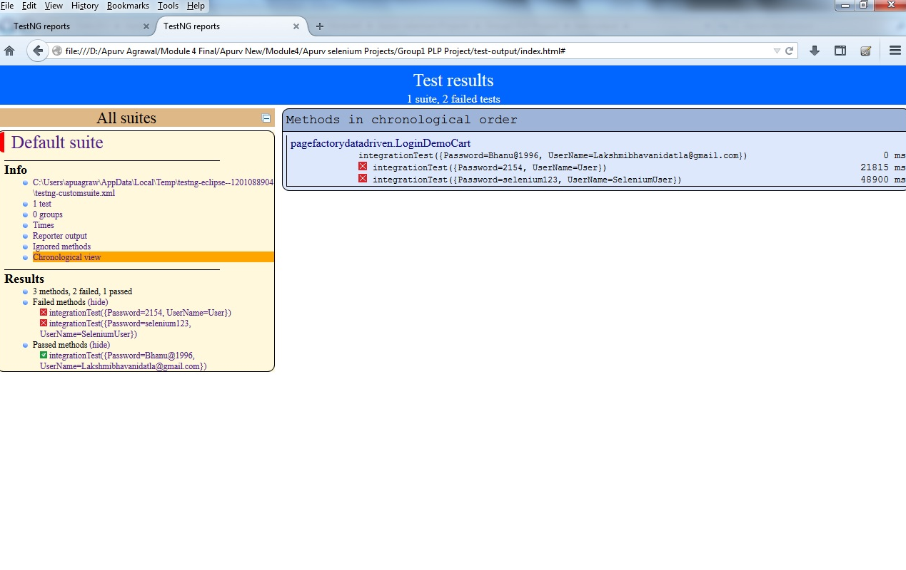
HTML REPORT FOR LOGIN

Slide 13
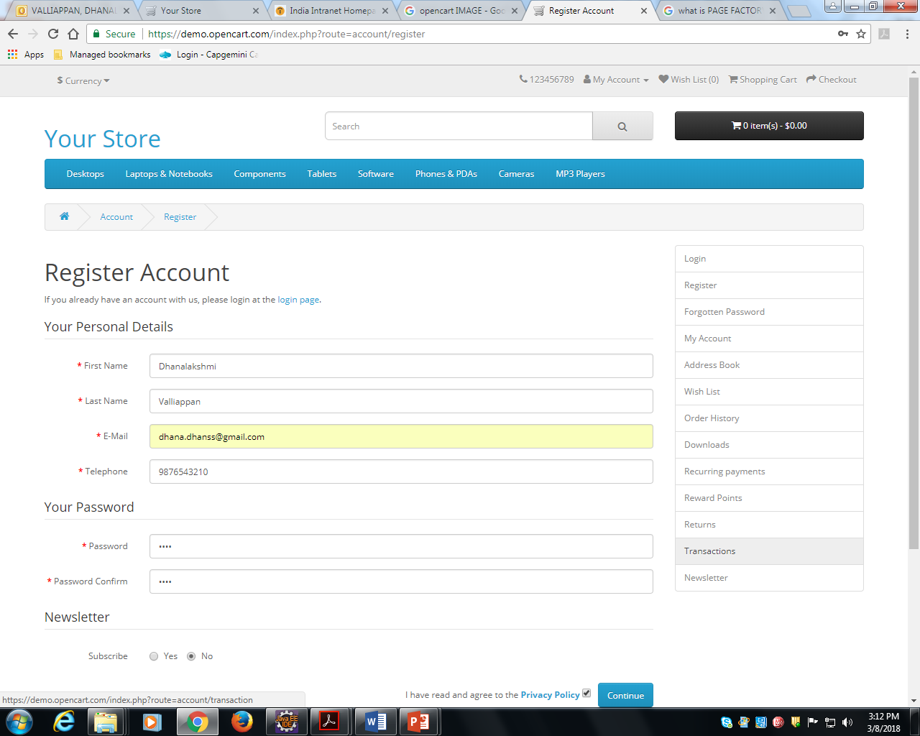
REGISTRATION PAGE

Slide 14
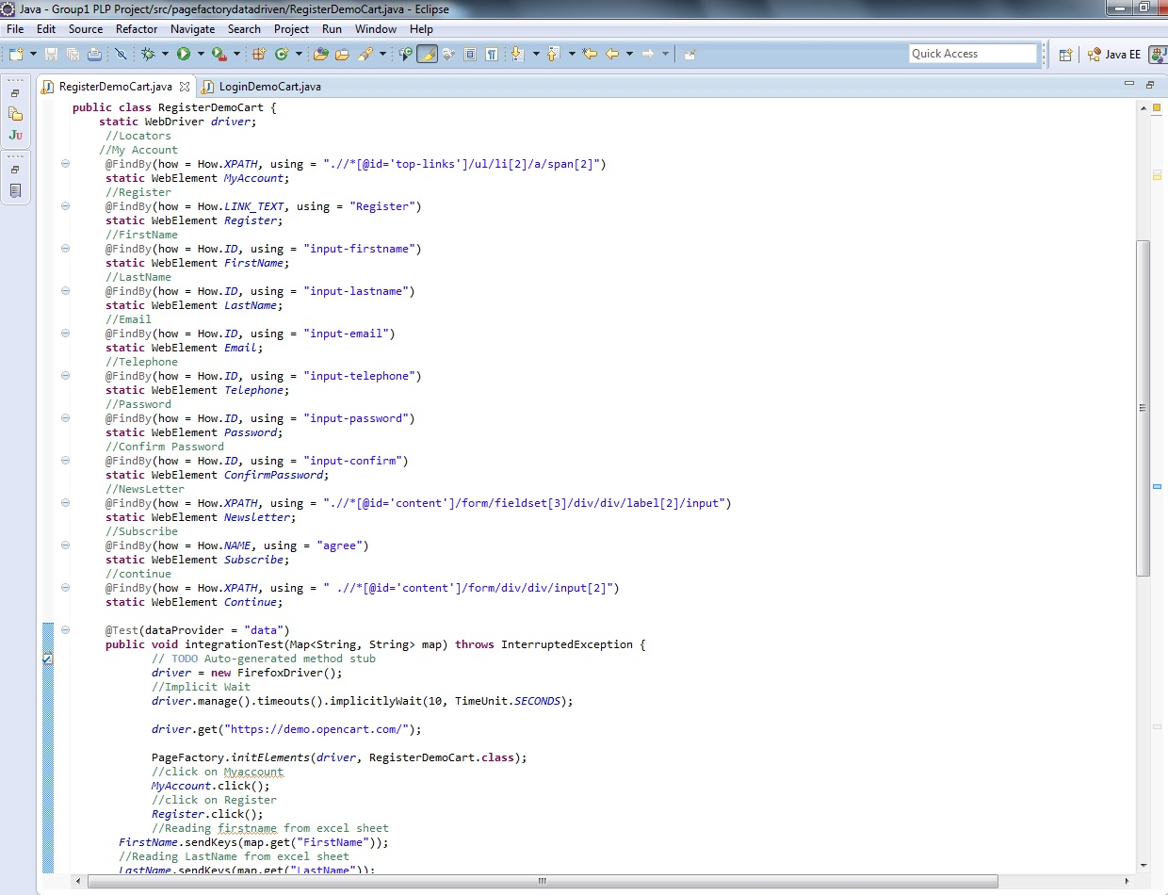
ECLIPSE CODE FOR REGISTRATION

Slide 15
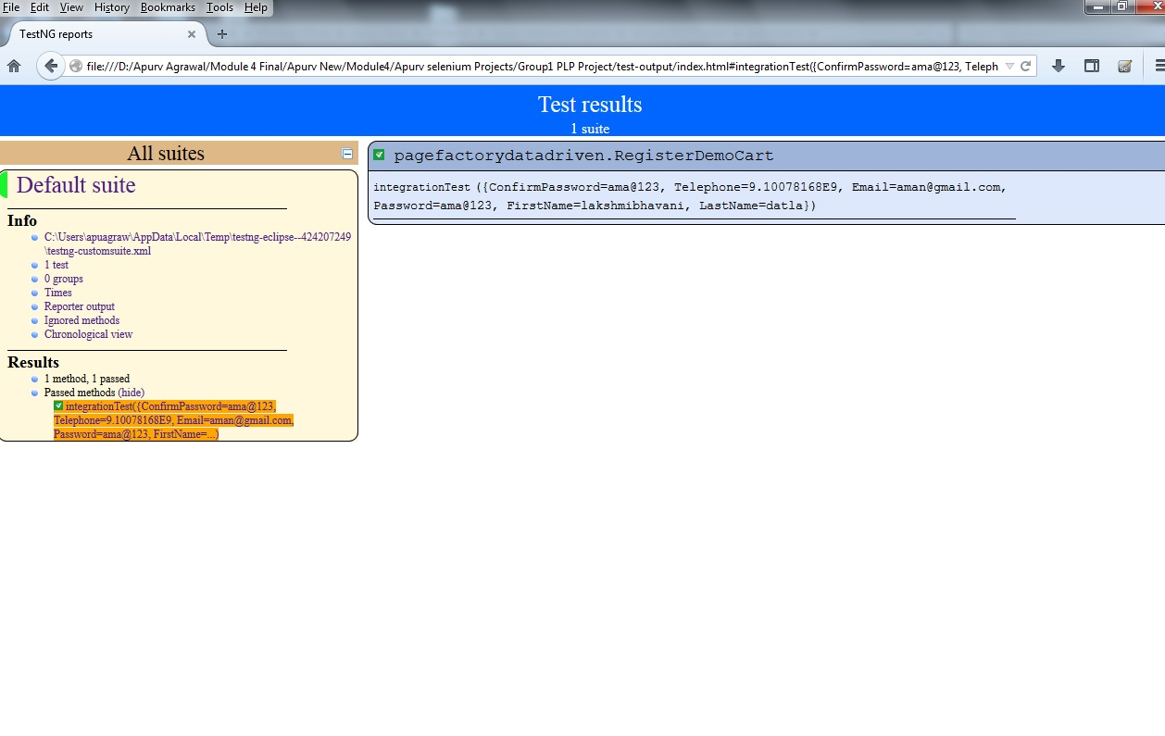
HTML REPORT FOR REGISTRATION

Slide 16
TEST SUMMARY
We have tested the functionalities;-
User Login
Login
User Registration
Registration

Slide 17
TEST SUMMARY Cont..
Test Cases
Total No. of Test cases =
Program
Total No. of Programs= 2
Total No. of test cases passed =
Total No. of Test cases failed =
People Worked
No. of People worked in this project = 8

Slide 18

Thank You ! Q & A

